Slide 1
A Revolution in Integrated Circuit Amplifier Design
Ed Fong UC Santa Cruz – Silicon Valley

Slide 2
Review of amplifier requirements
Virtually all analog processing requires precision amplification.
Most RF amplifiers are not NOT precision amplifiers. Their job is just to amplify the signal.
Example - RF Front end - is just a amplifier with gain (eg. 10dB, 12 dB. Etc. You can do this with tuned circuits and no precision is needed. You are just looking for gain.
Precision Feedback is not needed.

Slide 3
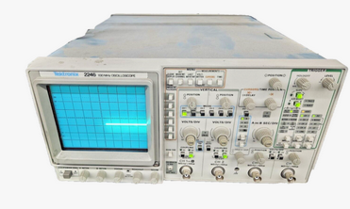
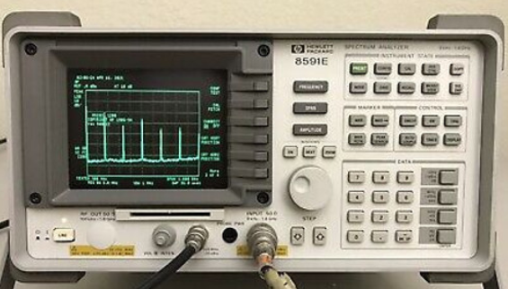
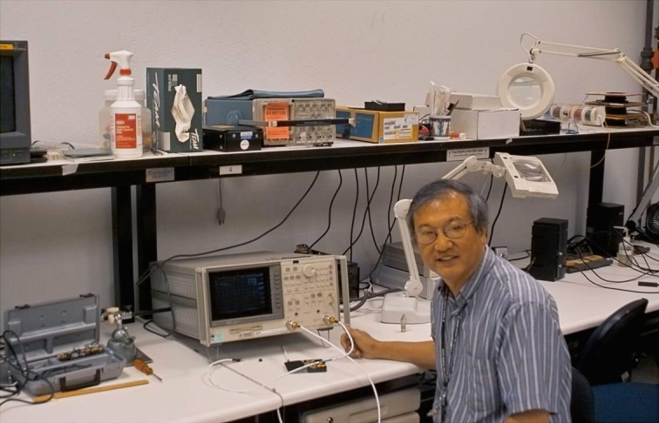
HP 8591 retail for about $25K
Tektronix 2246 Scope $2k
All these instruments require precision amplifiers - approaching 100dB of precision. That’s about 0.001%.
HP 8753C network analyzer $90K

Slide 4
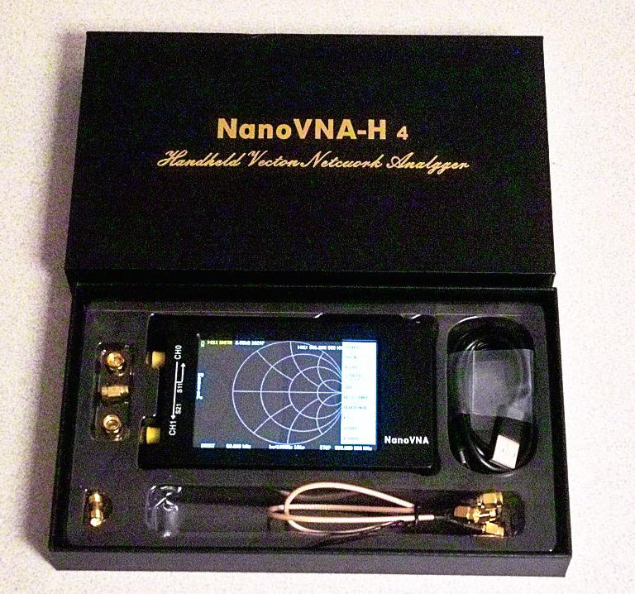
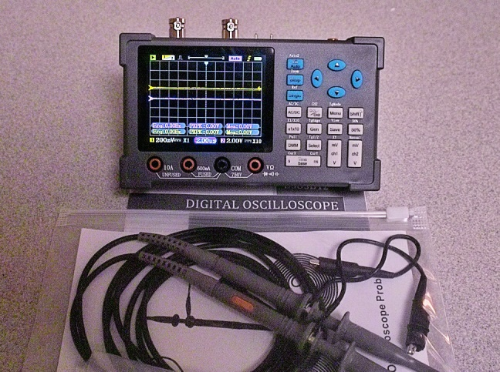
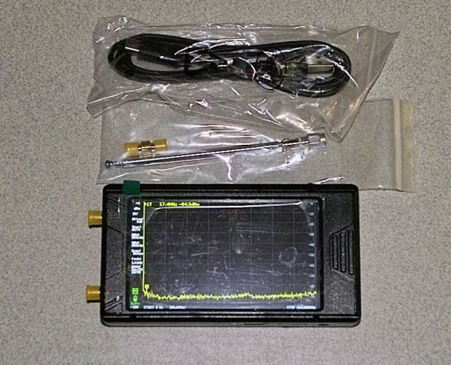
DSO 03D12 - 120 MHz scope, FFT spectrum analyzer, signal generator, and DVM $135
NANOVNA 1.5 GHz network analyzer $95
So what is the break through in technology?
NANO SA 5 GHz Spectrum analyzer $155

Slide 5
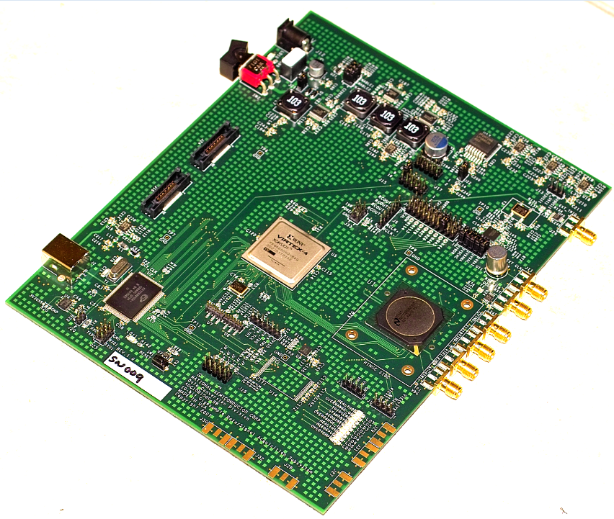
4 GHz Spectrum analyzer using no tuned circuits. Presented here 2013.

Slide 6
It is a different story when you require precision such as in oscilloscopes, network analyzers, and spectrum analyzers.
These instruments are accurate to at least 12 bits. 0.025% accuracy. Some instruments even go the full 16 bits. We are talking then to 0.001% (who’s counting). That is 96 dB’s.
In order to develop instruments like the Nano SA , Nano VNA, DSO3D12 scope you need not only amplifiers that give you 96 dB’s of dynamic range but you need them to go up to the several GHz and still maintain the accuracy.

Slide 7
IMPOSSIBLE???? Let’s just review how hard this really is.
A simple precision amplifier is the well know μA741 op amp.

Slide 8
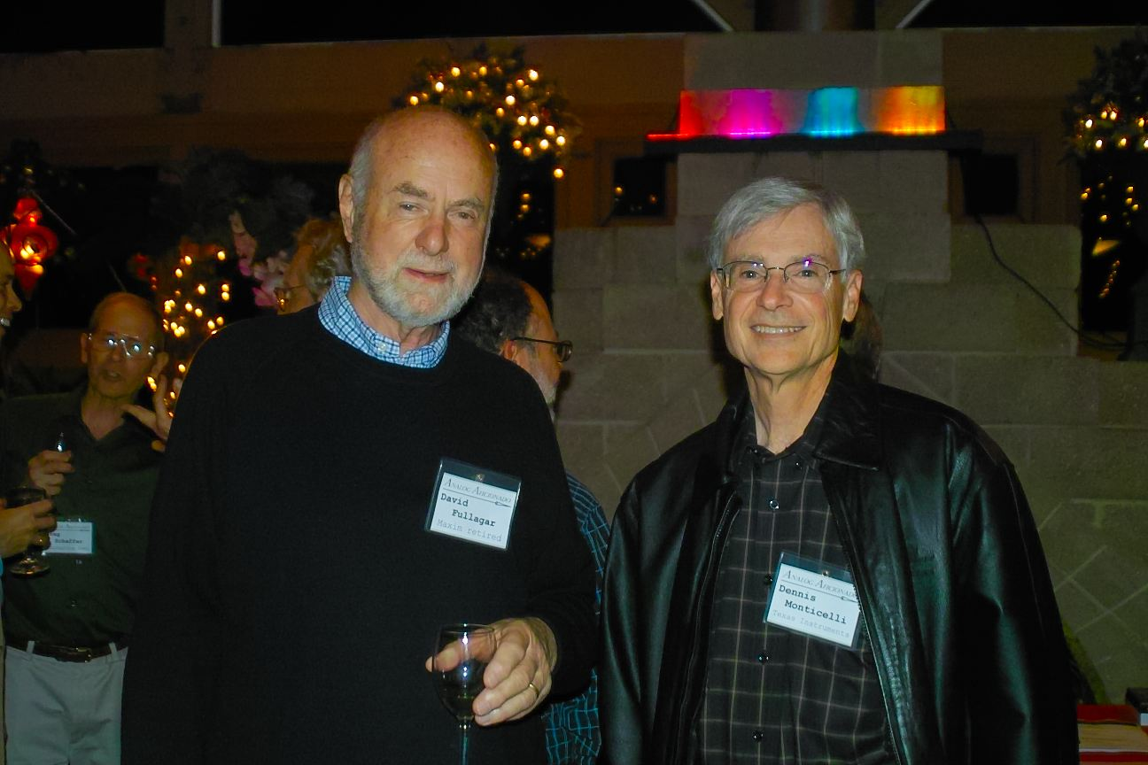
The ubiquitous μA741 is among the most popular designed by Dave Fullagar at Fairchild back in the 1968. Earlier op amps included μA702 designed by Bob Widlar. Dennis Montecelli designed one of the first commercially available high performance CMOS op amps.
Dave Fullagar (μA741) and Dennis Monticelli (designer of the LMC660 CMOS op amp)

Slide 9
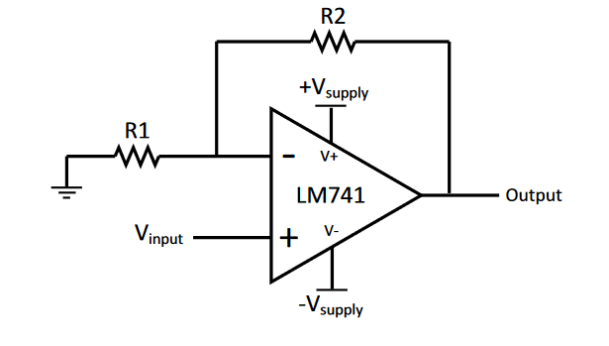
Vout = Vin (1+R2/R1)
Precision is based on precision of R2 and R1
Assumes op loop gain as high >100,000

Slide 10
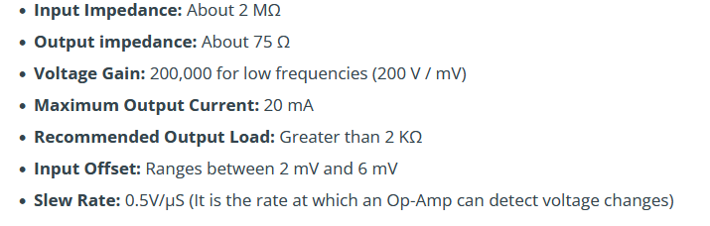
Typical μA 741 op amp spec sheet

Slide 11
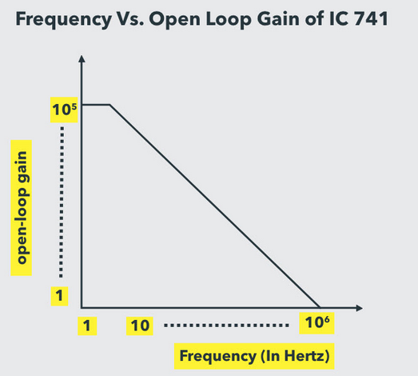
Notice that by 1 MHz the gain has drop to almost 1 which makes the amplifier unusable for precision operation beyond 100KHz.

Slide 12
Without getting into the math, why does this happen?
Basically it is the delay of the amplifier stage.
input
output
Suppose this amplifier has a 1uSec (1 MHz) delay. With feedback , the amplifier can only process a signal at best 0.3 MHz to be effective.
For a 1 MHz signal it would be 180 degrees out of phase. The amplifier will go into oscillation since this is positive feedback.

Slide 13
This is because the negative feedback reapplied to the input is too late to be affective after going through the amplifier.
For 30 years amplifier designers sat on this problem. For a precision amplifier you need large open loop gain. For large open loop gain, you need several stages of gain.
Several stages of gain must be accompanied by DELAY. With delay you cannot close the loop and expect a high frequency response.

Slide 14
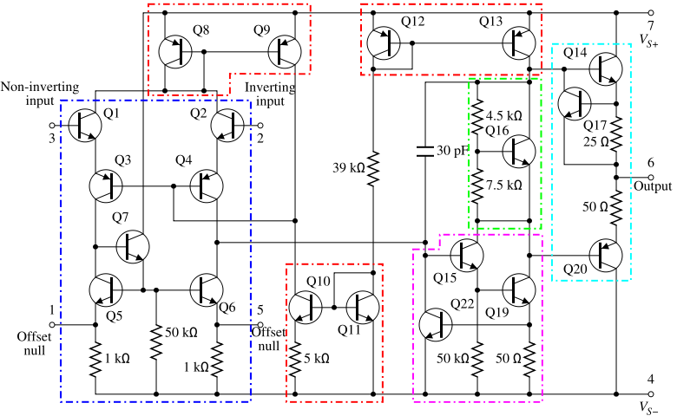
Simplified schematic of the μA 741 -

Slide 15
Some basic explanations on the μA741 –
The input stage (Q1 and Q2) uses an emitter follower and only provides for current gain, not voltage gain. 1st pole is very high. It basically serves as a high impedance buffer.
Transistors Q3 and Q4 are in common base configuration
Transistors Q5, Q6, and Q7 form a current mirror to convert the differential signal to a single ended signal.
Transistors Q15 and Q19 form a darlington “high beta” transistor “beta_Q15 x beta_Q19” for high voltage gain. The dominant pole is also formed here.
Transistor Q16 with two biasing resistors forms a “Vbe multiplier” to bias the output stage.
Transistors Q14 and Q20 form the emitter follower “push pull” output stage.
Transistors Q17 and Q22 is used for output protection.

Slide 16
What was stopping our progress for 30 years?
There are literally thousands of papers published on op amp improvements.
Pole zero compensation, current mode feedback, nested loop compensation but it basically still does not solve the problem.
It comes down to fundamentals.
If you apply feedback to achieve precision, the frequency response of the amplifier dramatically decreases due to the signal delay through the amplifier.
This was a STONE WALL.

Slide 17
Sometime in the late 1990’s – at least at National Semi conductor - there was meeting – at meeting of the minds. Some of the smartest folks in the Industry of Analog Circuit Design. These included famous folks like Bob Pease, Dennis Monticelli, Larry Lewicki, and JimWeiser
Question - what is stopping us from going forward with innovative analog designs? Are we done?
Incremental improvements were not good enough.
We need a Revolution in Amplifier Design.

Slide 18
Conclusion - Limitation of virtually any analog function (ADC, DAC, filters, PLL, etc.) is the Precision Amplifier.
That is - Whatever frequency response your amplifier technology can do is what your limitation will be.
That simple.
Assigned to the Guru’s of amplifier designs at National Semiconductor –
We don’t care how you do it. We don’t care if it is non traditional. We don’t care if it uses capacitors, clock sampling, autozero, CMOS, BiCMOS, Bipolar. Even power consumption.
We just care about – GAIN, FREQUENCY RESPONSE – we can deal with the rest, but without gain and frequency response we are stuck.

Slide 19
The theory says - with GAIN and FREQUENCY response, the sky is the limit.
Without the math to prove it, it is not difficult to convince one that whatever your amplifier limitations are that is the limit of your application.
Simply stated, if your close loop gain of your amplifier is 4GHz then you can build spectrum analyzers, signal generators, network analyzers up to those frequencies without expensive tuned amplifiers.

Slide 20
That is quite a statement.
Here is what we know –
- We must have gain
You need to do it with ONE stage- otherwise the delay will be too long
That is really hard.
It was previously thought that high gain required multi stages
x10
x10
x10
This may give a gain of x1000 but you could never close the loop with feedback without major problems with oscillations or very low frequency performance.

Slide 21
So what does it come down to? ONE STAGE with gains of at least 100,000 open loop.
Most folks would just give up.
Not the team a National Semiconductor.
In a standard differential pair, you will DC level shift up after each stage. Can you really afford another stage to level shift DOWN? NO
If you do this with PNP or PMOS, you will still have the same problem except now it level shifts down, not up.

Slide 22
Differential Pair
VCC
VCC
Reference current
vout
out
Q
Q*n
Vin+
Vin-
Current Source
Differential Pair
Good voltage swings
Common mode output voltage goes up

Slide 23
Solution - Capacitors restore DC common mode voltage
This is DC block so what appears on the left side of the input capacitor can be anything. The switches autozero the input offset.
Sometimes it is necessary to put level shifting in the auto zero circuit to preserve the dynamic range.
Because of the capacitors and infinite high impedance of the amplifier, you can store analog levels with the amplifier powered down. This is essentially a VLSI systems on chip.
+
-
vin
vout
-
+

Slide 24
VCC
RL
out
In
Av=- gmRL
gm=Ic/Vt
RE
Common emitter with bypass capacitor
In order to get gain really high gain - you need high gm (transconductance) transistors and high RL - the load resistor.

Slide 25
VDD
VDD
Totem Pole load - we have found that this is a very effective single stage differential amplifier. Why??
A pure resistive load cannot give you the desired gain. The active load transistors here have very high output impedance. Remember Av=-gmRL . In addition, the transistors going to bias1 are in a cascode configuration. Thus first order Miller affect is avoided.
bias3
bias2
Vout-
Vout+
bias1
The p channel transistors that go to bias 2 and bias 3 form what is called a cascoded load. It offers very high impedance. Thus the impedance at the output node is equivalently very high. In the range of 100K ohm equivalent.
Vin+
Vin-
Believe it or not, a single stage amplifier like this can offer gains of x10,000.
ibias
GND

Slide 26
So why don’t people use amplifiers like this? This is very deceiving. The amplifier concept looks simple. It turns out the signal path is only half the problem. Notice that I left out the bias. If we had infinite VDD, it would not be a problem, but we don’t. So biasing is very important. That’s the other half of the equation.
Gain boosting - before we go on to the biasing. About 20 years ago, gain boosting was discovered. Gain boosting places a very clever twist on the load. This is shown in the next slide in a simplified manner, just on one section.

Slide 27
Gain Boosting
VDD
VDD
bias2
How does this work? The idea here is to get the resistance at the output high to get high gain.
If M1 pulls down, M5 will have less current. This raises the voltage at the drain of M5, which raises the voltage at drain of M1. This basically keeps up the drain voltage of M1 or equivalently raises the resistance.
VDD
bias2
M3
M4
similar circuit as one on left side
M5
GND
Vin+
M1
M2
Vin-
This is a touchy circuit because it is a form of positive feedback so the overall loop of the gain boost circuit cannot exceed 1.
ibias
GND

Slide 28
I
I
g4
g4
g3
g3
drain
drain
g2
gate
g2
gate
g1
source
g1
source
Mosfet
Mosfet
V
V
Real life Mosfet
Ideal Mosfet – gain boost circuit mimic this.

Slide 29
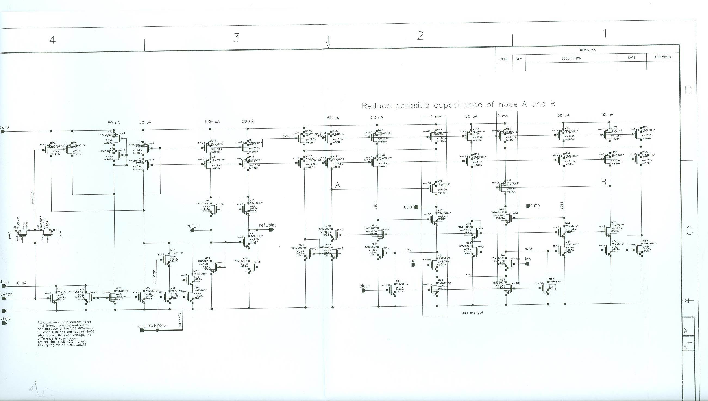

Slide 30
Biasing of the gain boost cascode is the other half of the challenge. If one had infinite VDD and power, then the problem is irrelevant. However, since we are talking about 1.5-2.5 volt VDD here, biasing is utmost critical.
It is quite contradictory - we want high speed and good dynamic range. The two do not go together. Historically voltage levels have dropped to gain on speed and reduce power.
Basically power is governed by P=IV and in the AC case
P = CV ²F
So for speed one compromises the trade off of voltage swing.
With a 2.5 volt supply, each device’s Vds must be optimized. If not, the headroom is limited.
In addition, if VDD varies, the biasing will collapse and the circuit will fail. A solution is to use tracking biasing.

Slide 31
VDD
VDD
VDD
VDD
bias1
bias2
VDD
I1
I2
Iref
GND
GND
GND

Slide 32
VDD
VDD
VDD
VDD
bias2
bias2
similar circuit as one on left side
M3
M4
Vin+
M1
M2
Vin-
ibias
GND
GND
GND
This is the p channel gain boost circuitry. Since there is not a current source at the top, the topology must be modified for biasing purposes.

Slide 33
So there we have it and this technique has revolutionized our world.
It is like breaking the sound barrier. We can now make precision amplifiers in the GHz range and thus produce instruments like VNA, spectrum analyzers, signal generators, oscilloscopes , etc. at a fraction of the cost.
Thank you for your time.

