Slide 1
Transport Stream
Monitoring and Other Cool Stuff
UniSoft Corporation
audrey@unisoft.com, grh@unisoft.com
June 2024
www.unisoft.com

Slide 2
Introduction
Software company, broadcast and cable focus. Founded 1981.
Reseller of a variety of products including Encoders, Schedulers, ATSC 3.0 stream generators, Infinity-Tech Rack Track.
TS Monitoring; Enensys StreamProbe.
DataDatacasting: with IEI for public broadcasters, with Ryarc for Broadcast Digital Signage.
System Integrator.

Slide 3
StreamProbe Overview
Monitors content quality (QoS/QoE) throughout the video processing chain.
Scalable solution.
100s of services monitored in parallel.
ABR playlist integrity.
ETR 101 290.
audio silence.
video freeze/black screen.

Slide 4
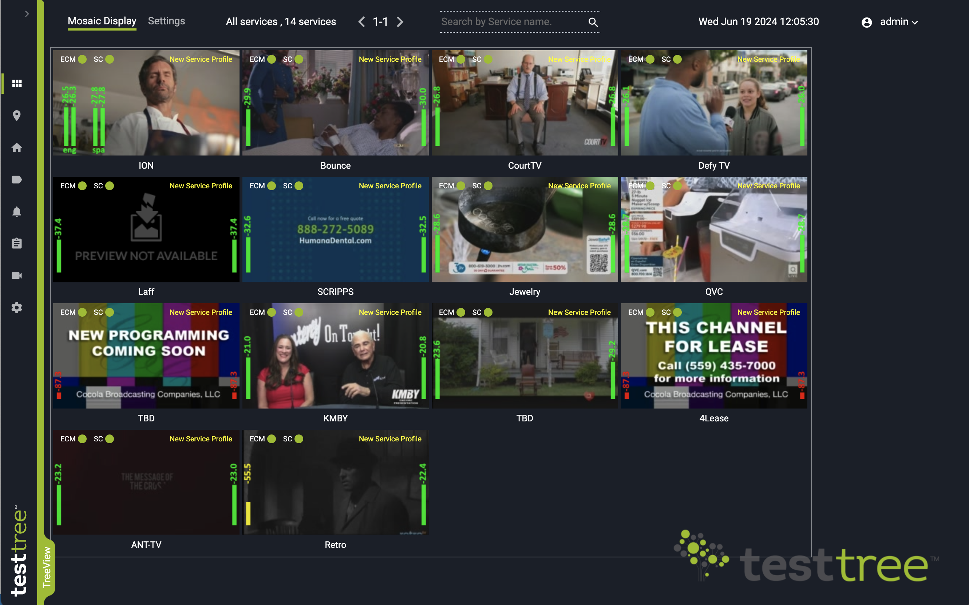
Configurable Mosaic

Slide 5
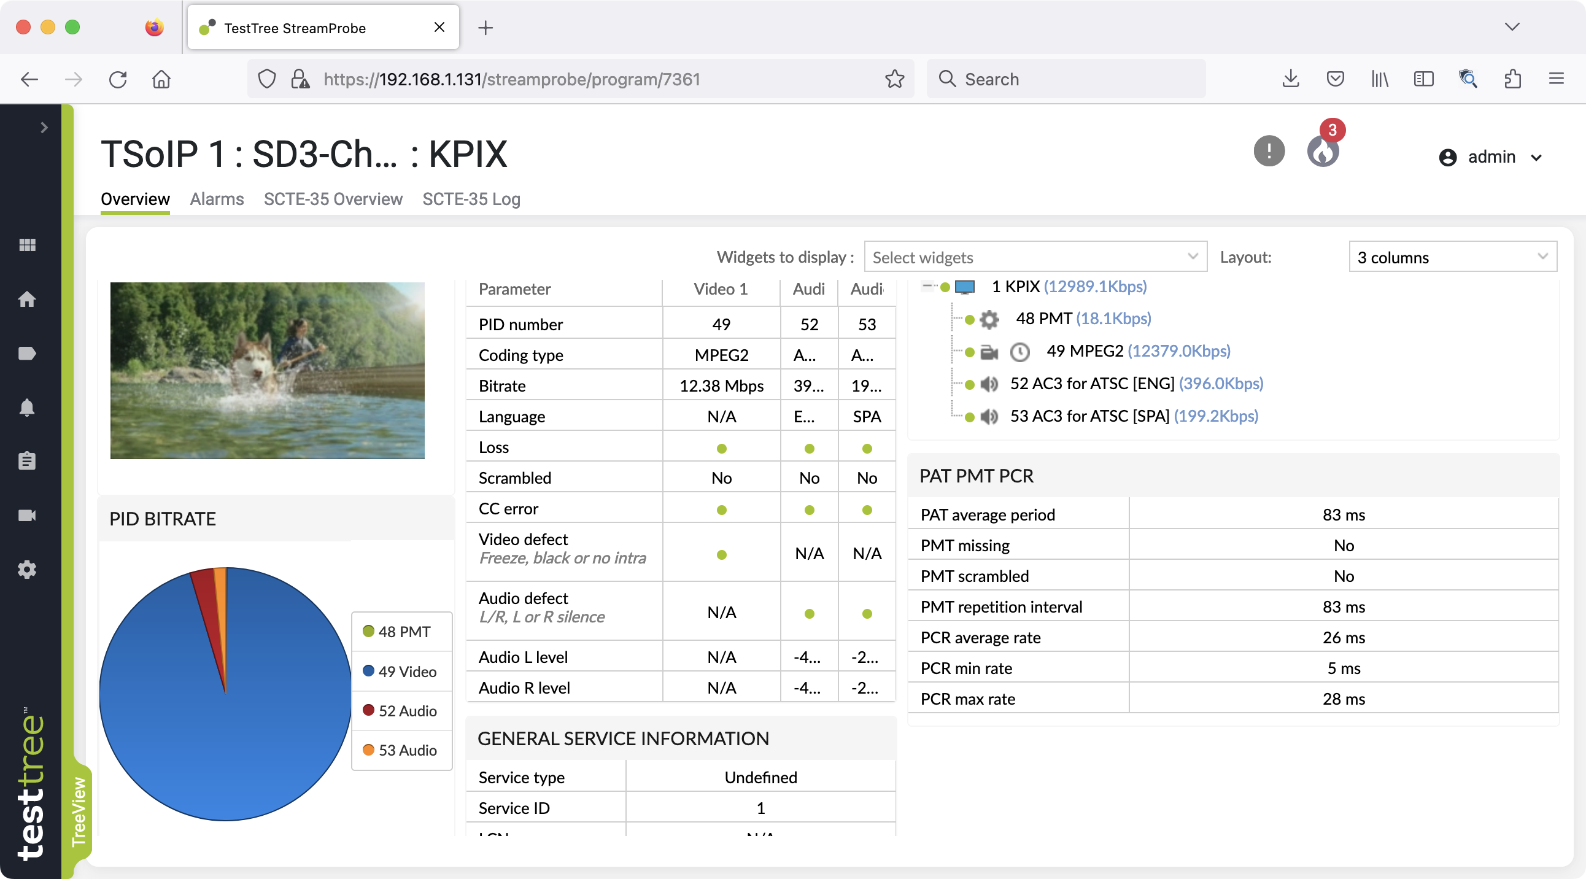
Drill Down to Analyze Issues

Slide 6
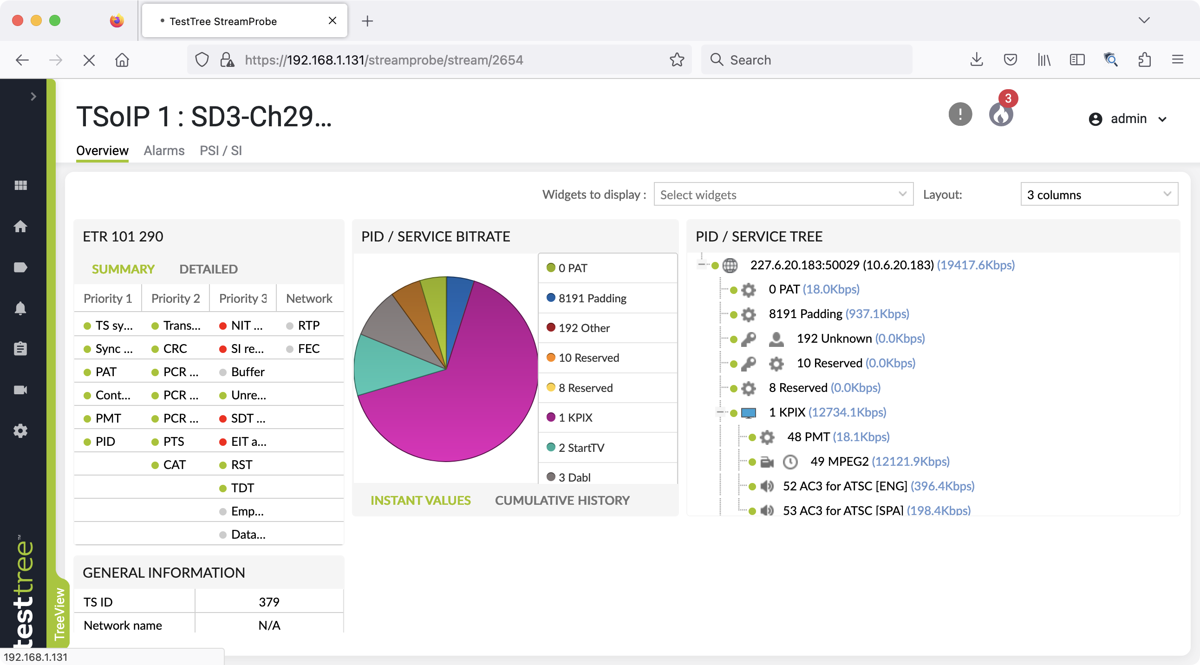

Slide 7
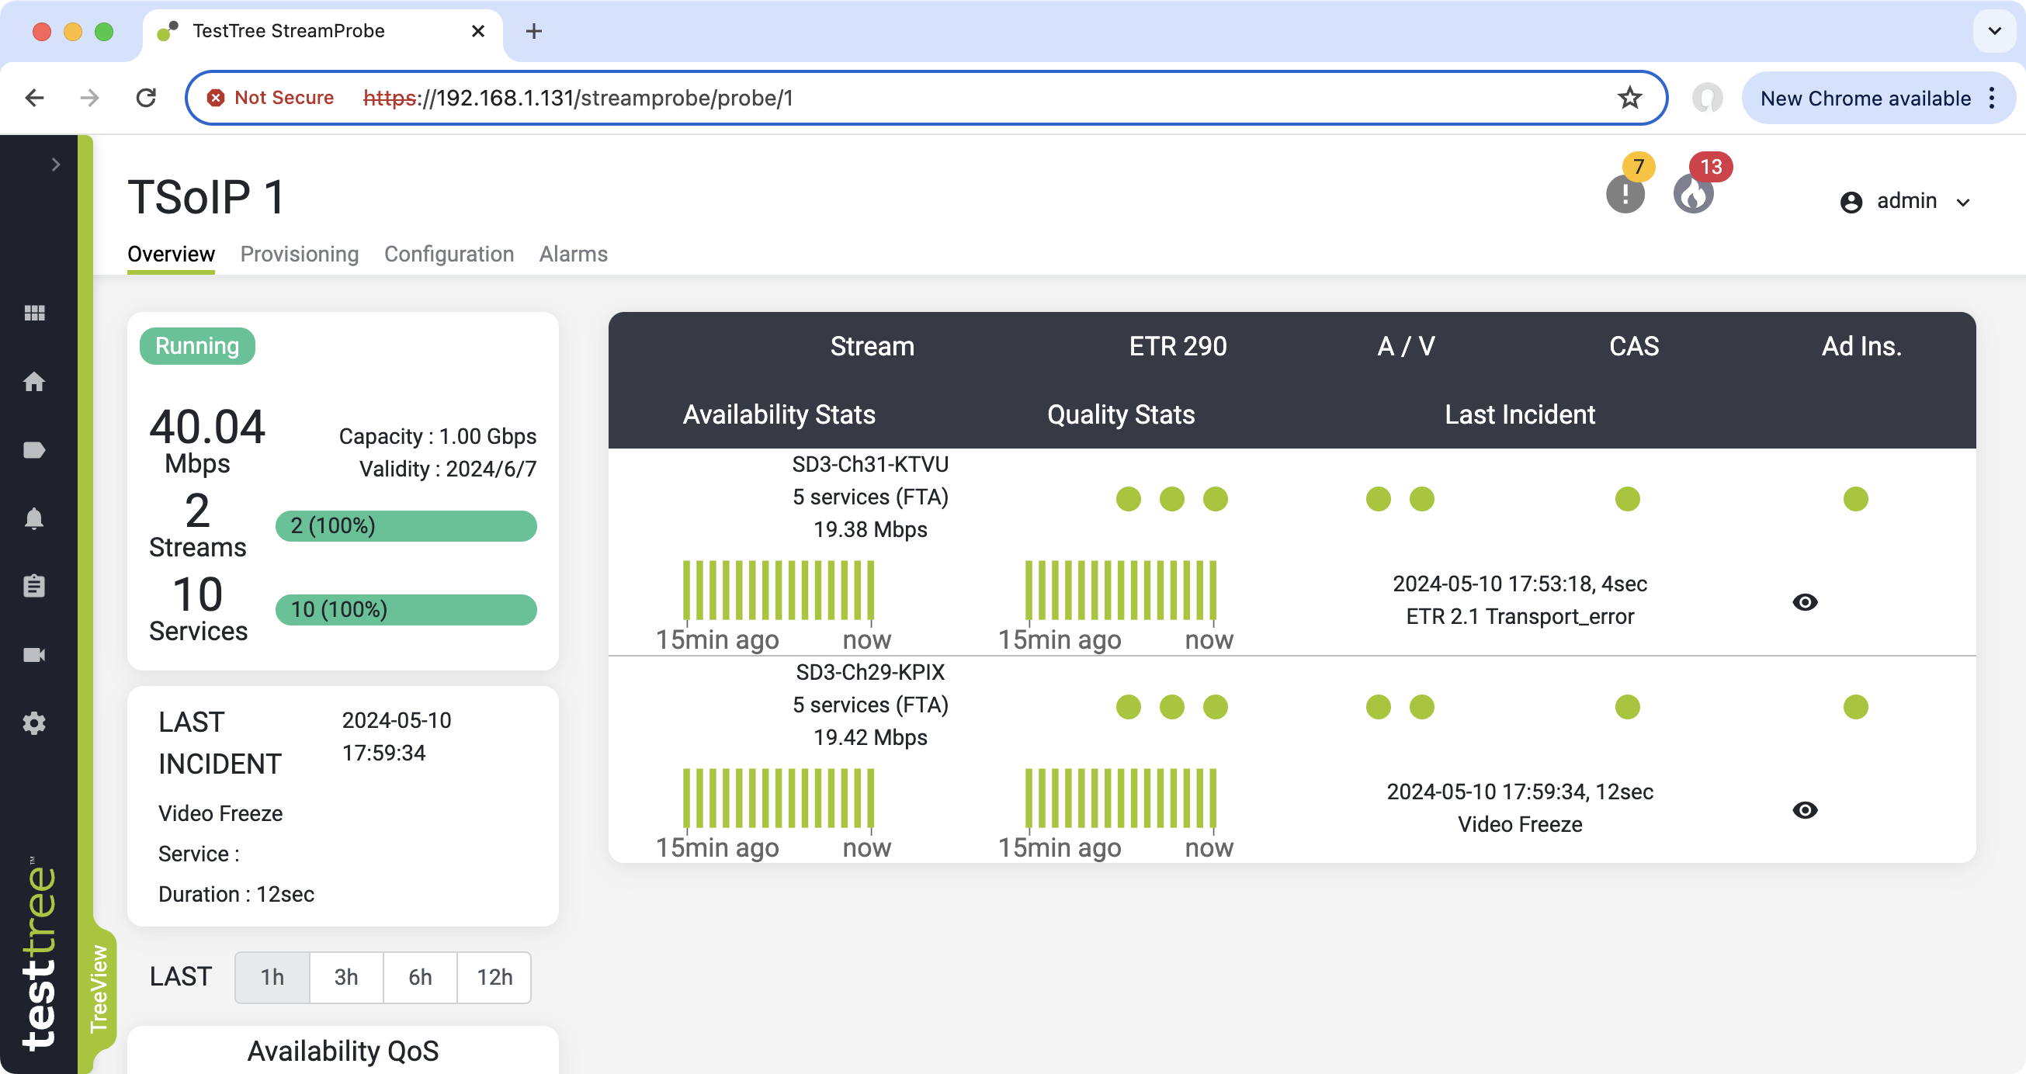
Per IP Node Capacities

Slide 8
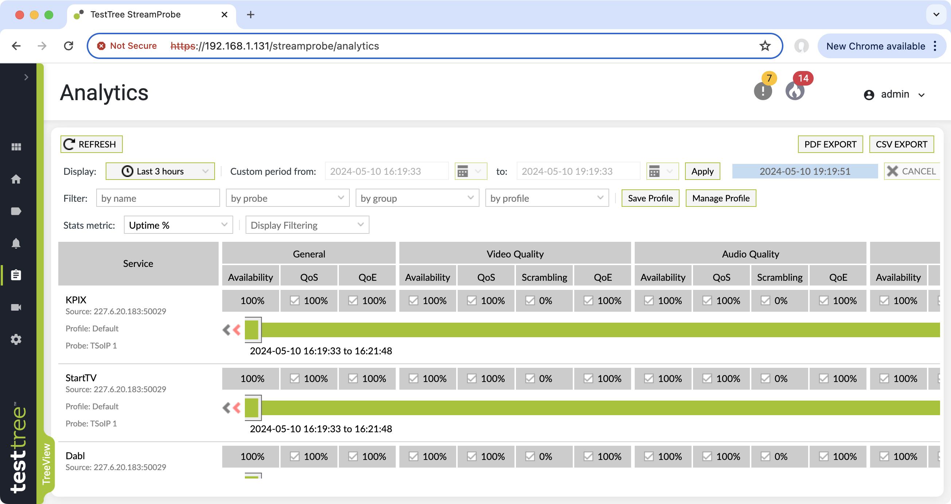
Analytics

Slide 9
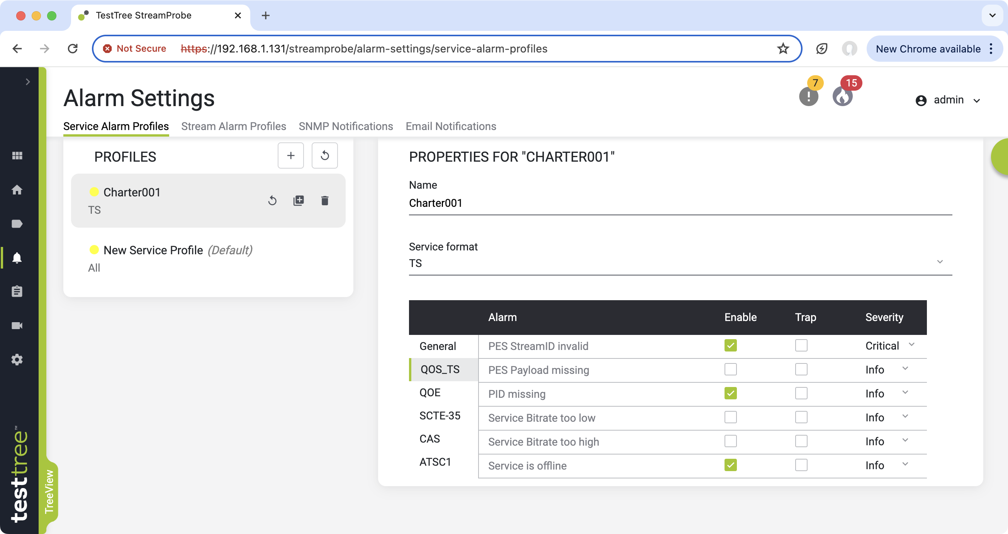
Alarm Profiles

Slide 10
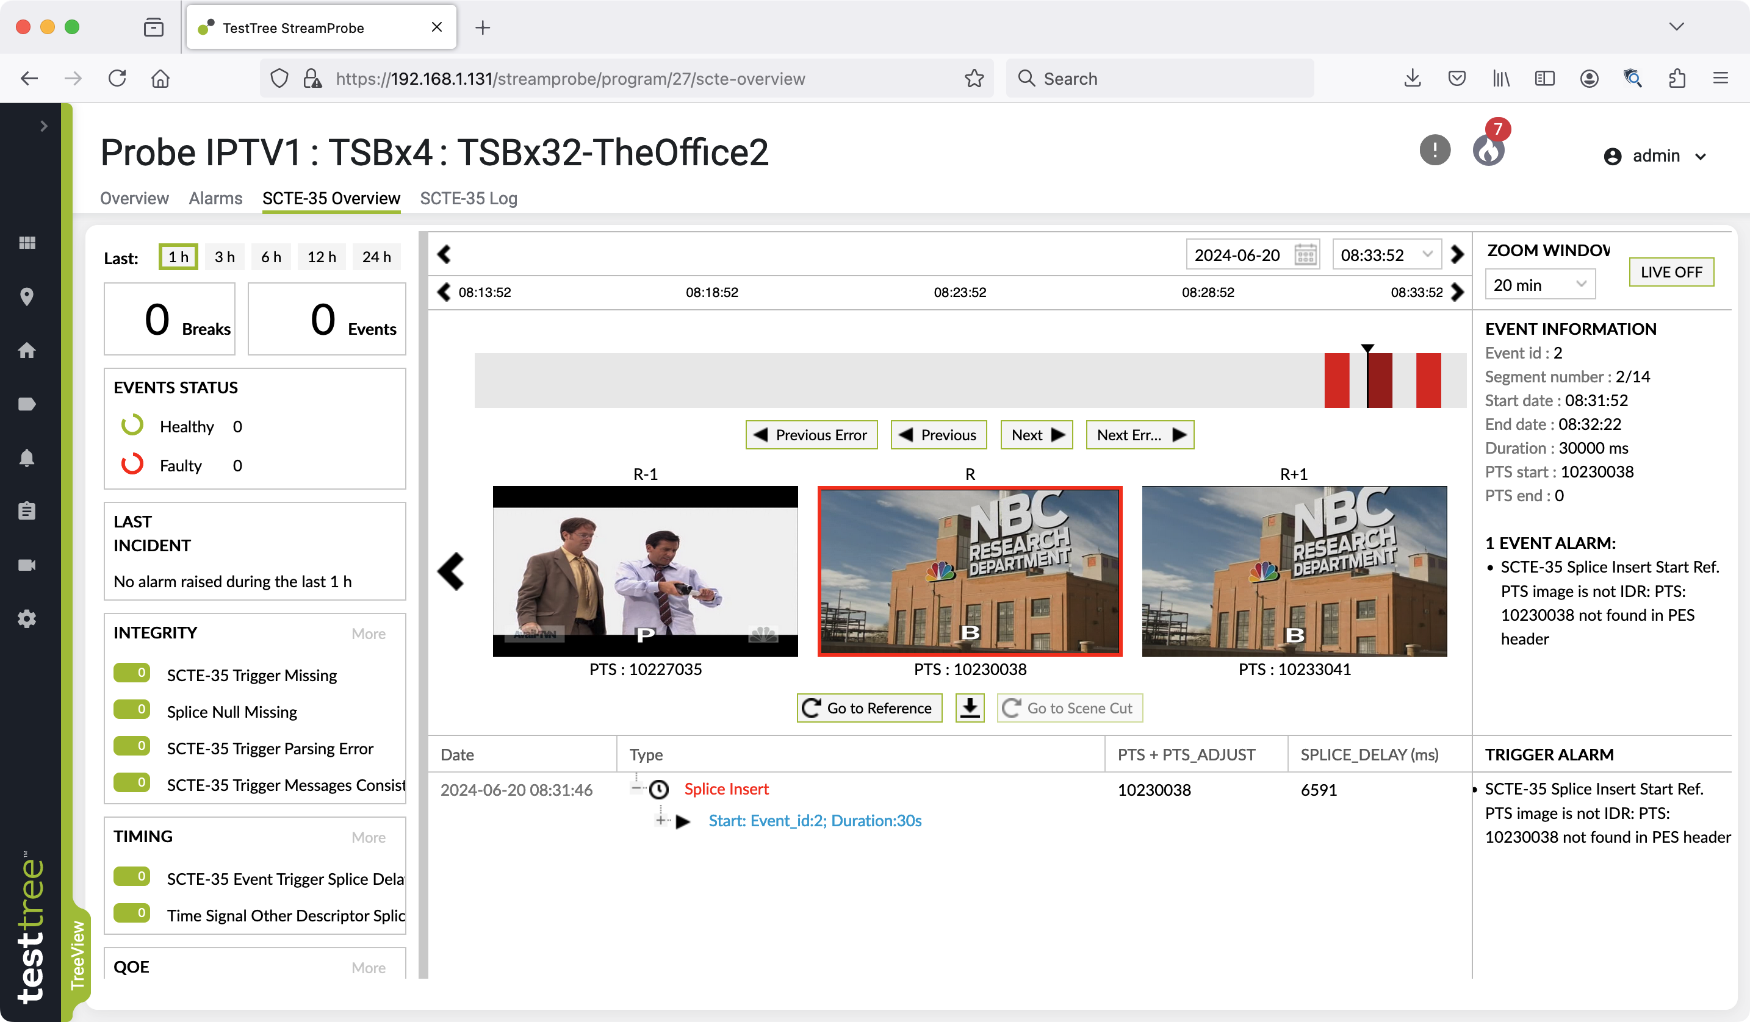
SCTE-35 Monitoring

Slide 11
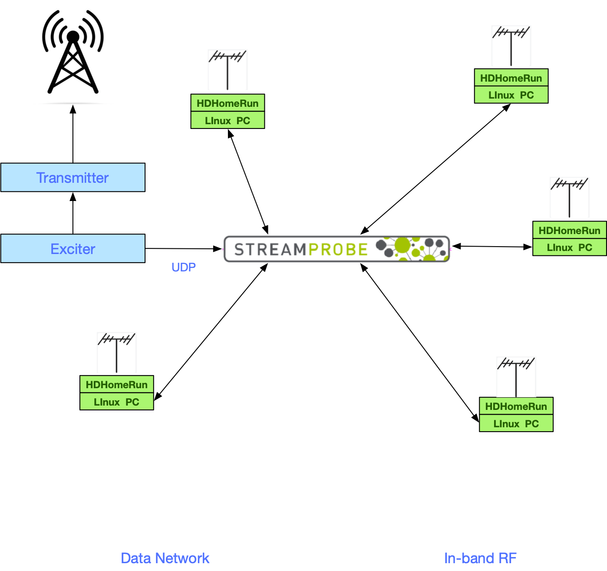
RF Edge Monitoring

Slide 12

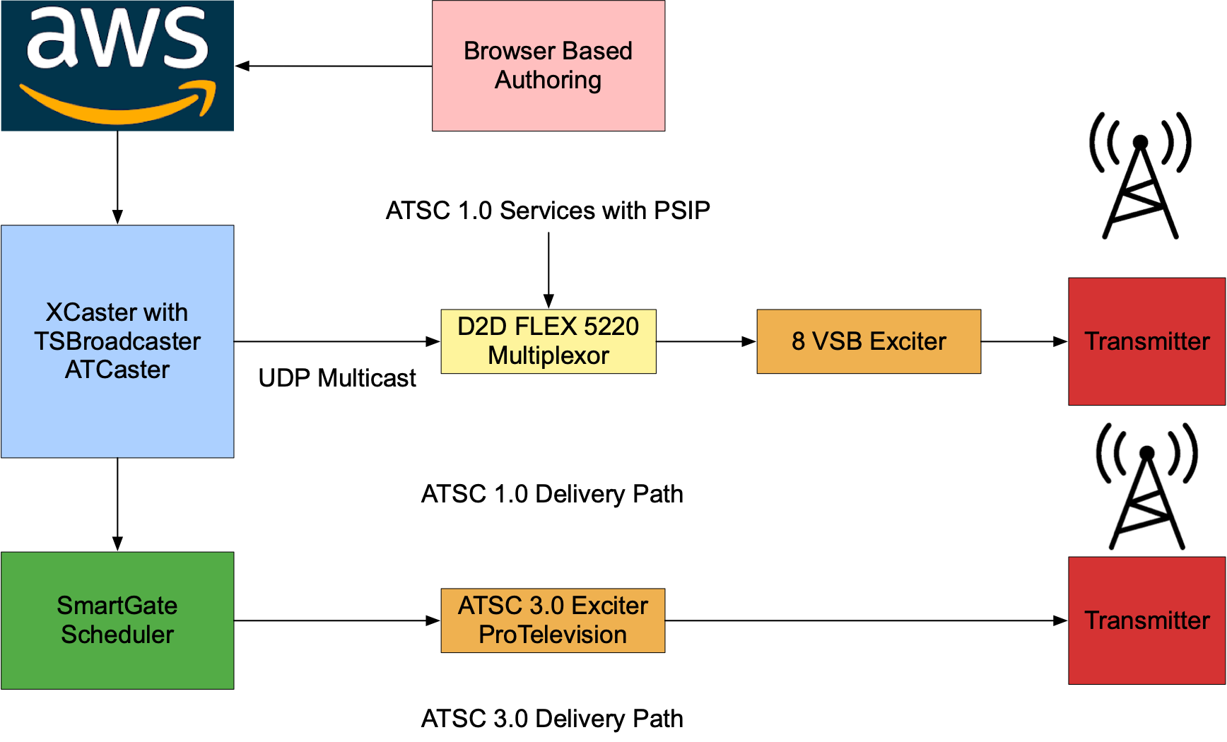
Remote Education/Medical Kiosks
12

Slide 13
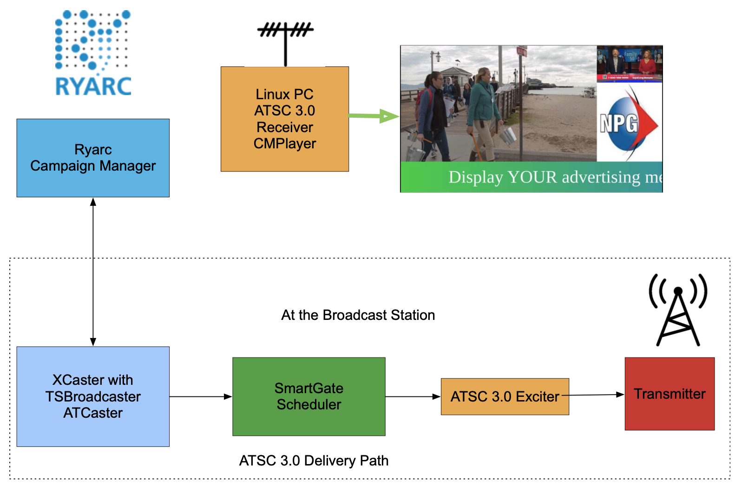
Broadcast Digital Signage

Slide 14

Digital Signage Example

Slide 15
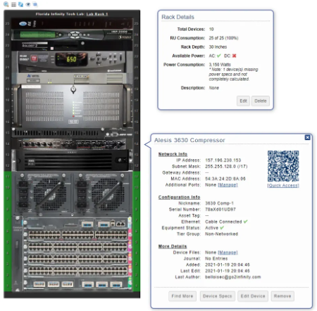
Rack Track - Inventory Management
Keep track of Serial Numbers and Asset Tags.
Show Network Info.
Device search by partial mac, IP address or device name.
See provisioned racks and which devices they contain.
Find out where there is space for new equipment.
Find out which devices are available for sparing.

Slide 16
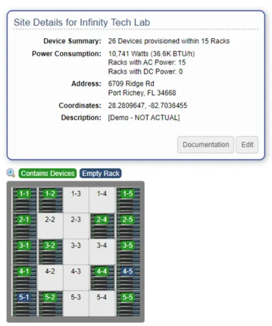
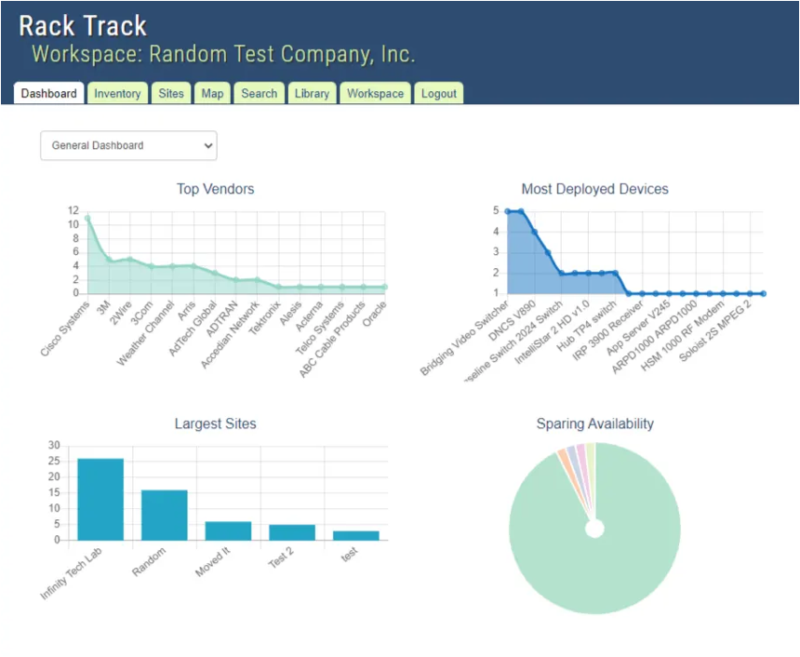
Rack Track Dashboard
See provisioned racks containing devices.
Get access to contents of a rack with a single click.
Show most provisioned devices.

